Slide 1
Whack a Mole
Jack Crowley, Rajiv Ramroop, Stacia Kolodziejski, Radhey Patel

Slide 2
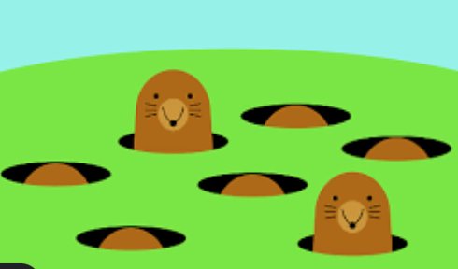
Project Goal
Design and create the whack a mole game using the FPGA board, LEDs, and buttons.
Improve our writing and understanding of Verilog code as well as the implementation on FPGA boards.

Slide 3
Design Specifications
The game starts with a 5 second counter, then counts down from 30 for the duration of the game. If the reset button is pressed, the 5 second countdown and the score will restart.
Once the 5 second timer is done, a random LED will light up and the user has to click the appropriate button for that LED.
Once the user hits the correct button, the score, which is displayed using the 7 segment display, will go up by one.
If the user does not hit the correct button, the score will remain the same and a different random LED will light up.
Each LED will remain lit for one second and if the user does not hit any button within one second, a different random LED will light up.
When the 30 second countdown ends, the LEDs stop lighting up and the game is over. The 5 second countdown only starts again if the reset button is pressed.

Slide 4
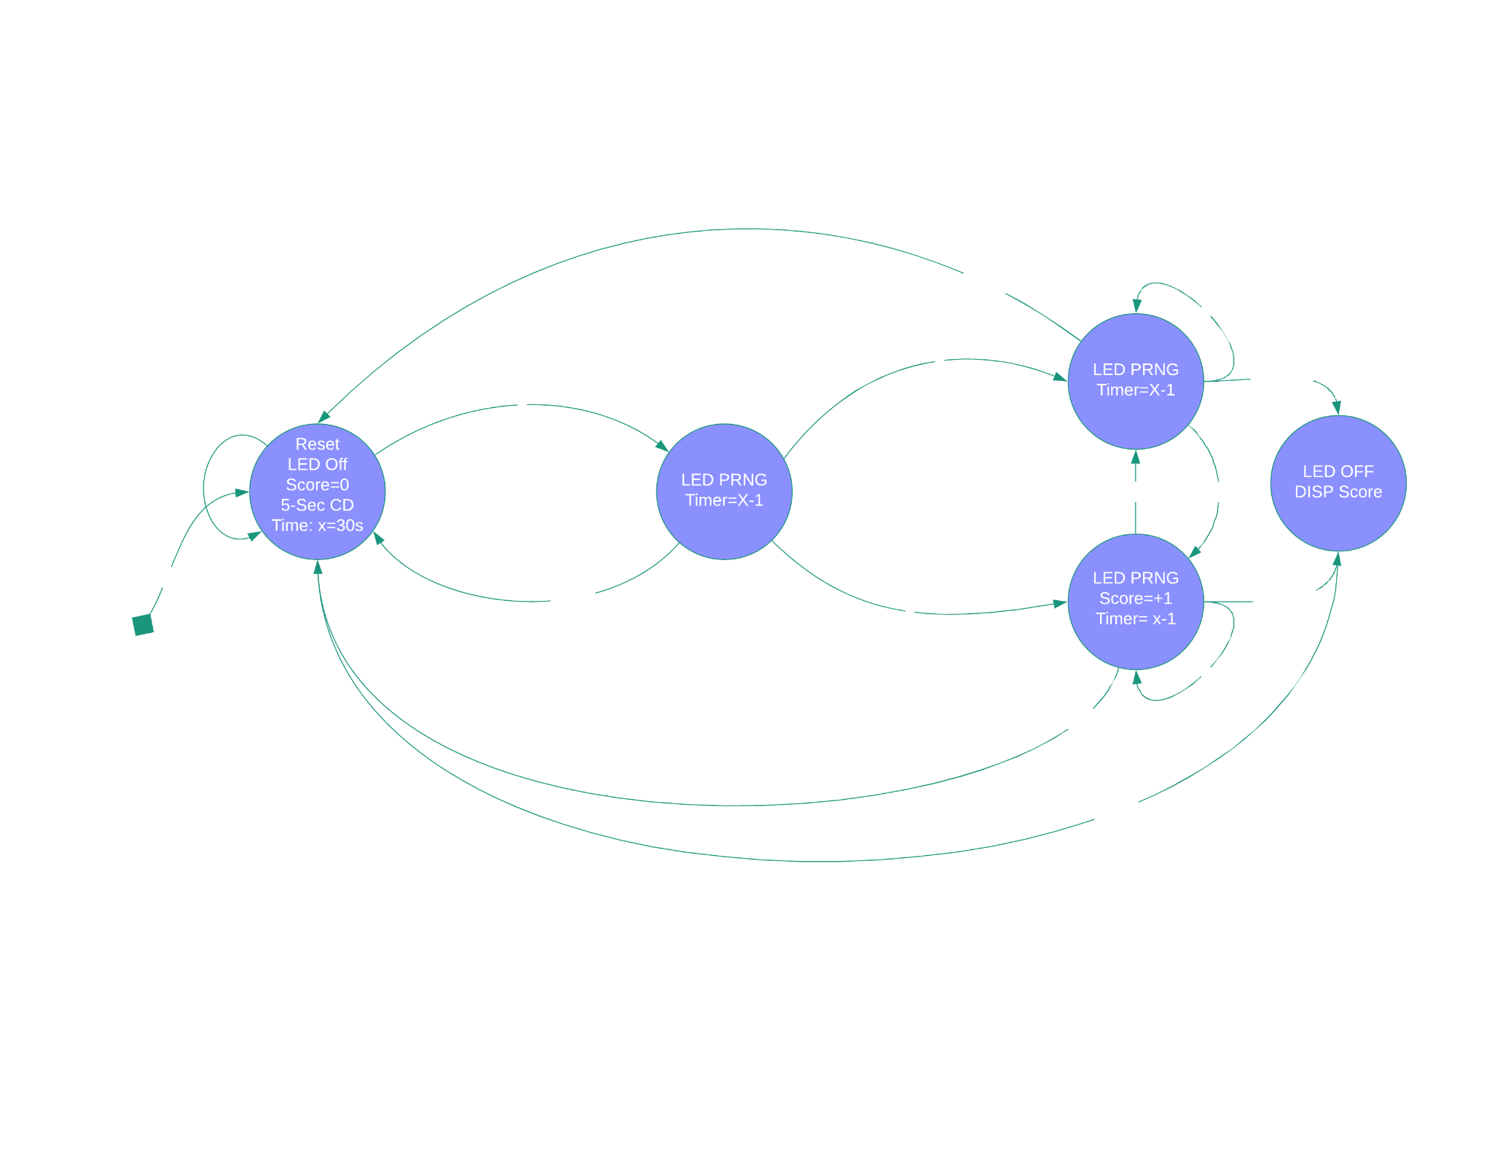
Design Functionality

Slide 5
Modules
5 Second Timer
Down counter from 5 to 0
30 Second Timer
Down counter from 30 to 0
1 Hz Clock Divider
1 second clock for each LED and both countdowns
2 Hz Clock Divider
Harder level of the game
Random Number Generator
Generates a random number to assign to the LED
Score Counter
Counts the score depending on how many correct buttons are pressed
Debouncer
Used for the buttons on FPGA
7 Segment Display
Displays the score
Binary to BCD
Converts binary input to BCD

Slide 6
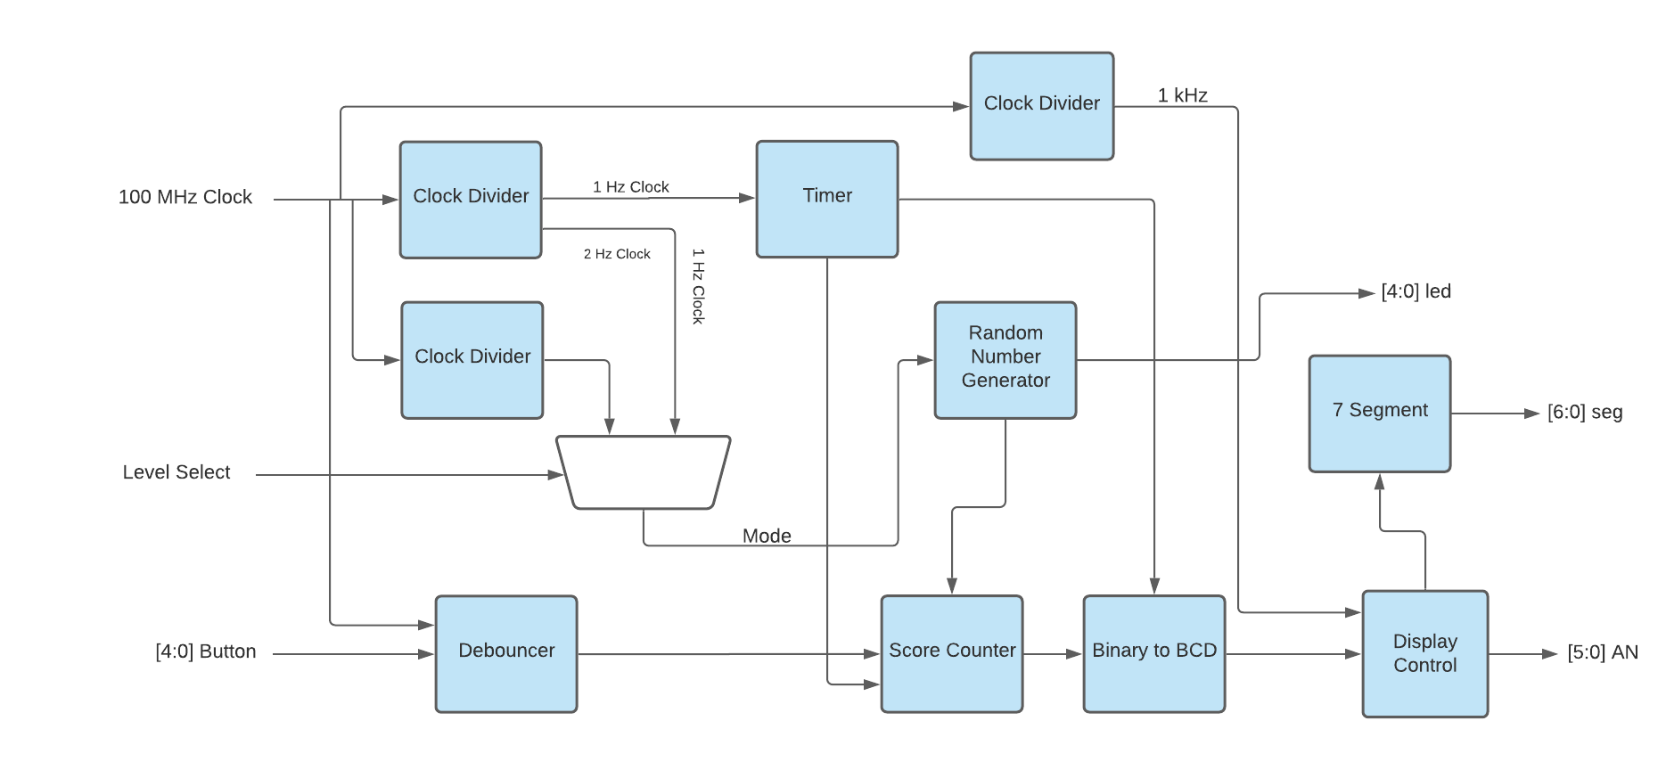
Design Functionality

Slide 7
Do’s and Don’ts
Do
Communicate effectively with team members
Plan out all diagrams and functionality before writing the code
Write code in advance and write testbenches to help with debugging
Be flexible with team members and keep an open mind
Use multiple modules
Don’t
Leave all the work and coding for the last minute
Give all work to one or two people
Write minimal number of modules

Slide 8
If we could redesign this project from scratch....
Add more levels to the game using different speeds for the LEDs to light up
Have a different way of pushing the buttons, or a different configuration of buttons on the board so that it is more user friendly
Make it more “Game- Like”, by displaying messages to users

Slide 9
Thank you!
Questions?

